Slide 1


Slide 2




Digital Dreamers
BS(CS) - Batch 2023 – NED’s Thar Campus
Ali Asghar
Muhammad Zaid
Munesh Puri
Suneel Timani

Slide 3
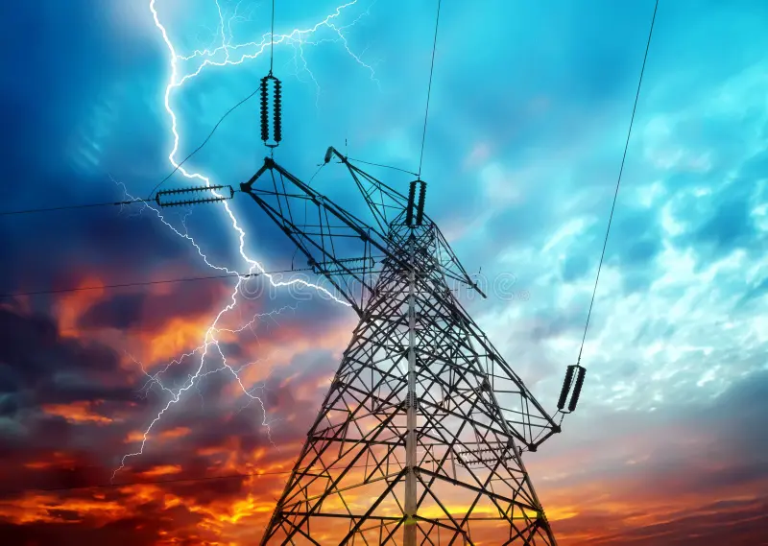
AI Smart Meter Behavioral Advisor: Introduction & Project Overview
Welcome to the future of energy management. This presentation introduces the AI Smart Meter Behavioral Advisor, a smart solution that uses AI and meter data to help users understand their energy use. It provides simple, personalized advice to encourage energy saving and smarter, more sustainable choices.

Slide 4
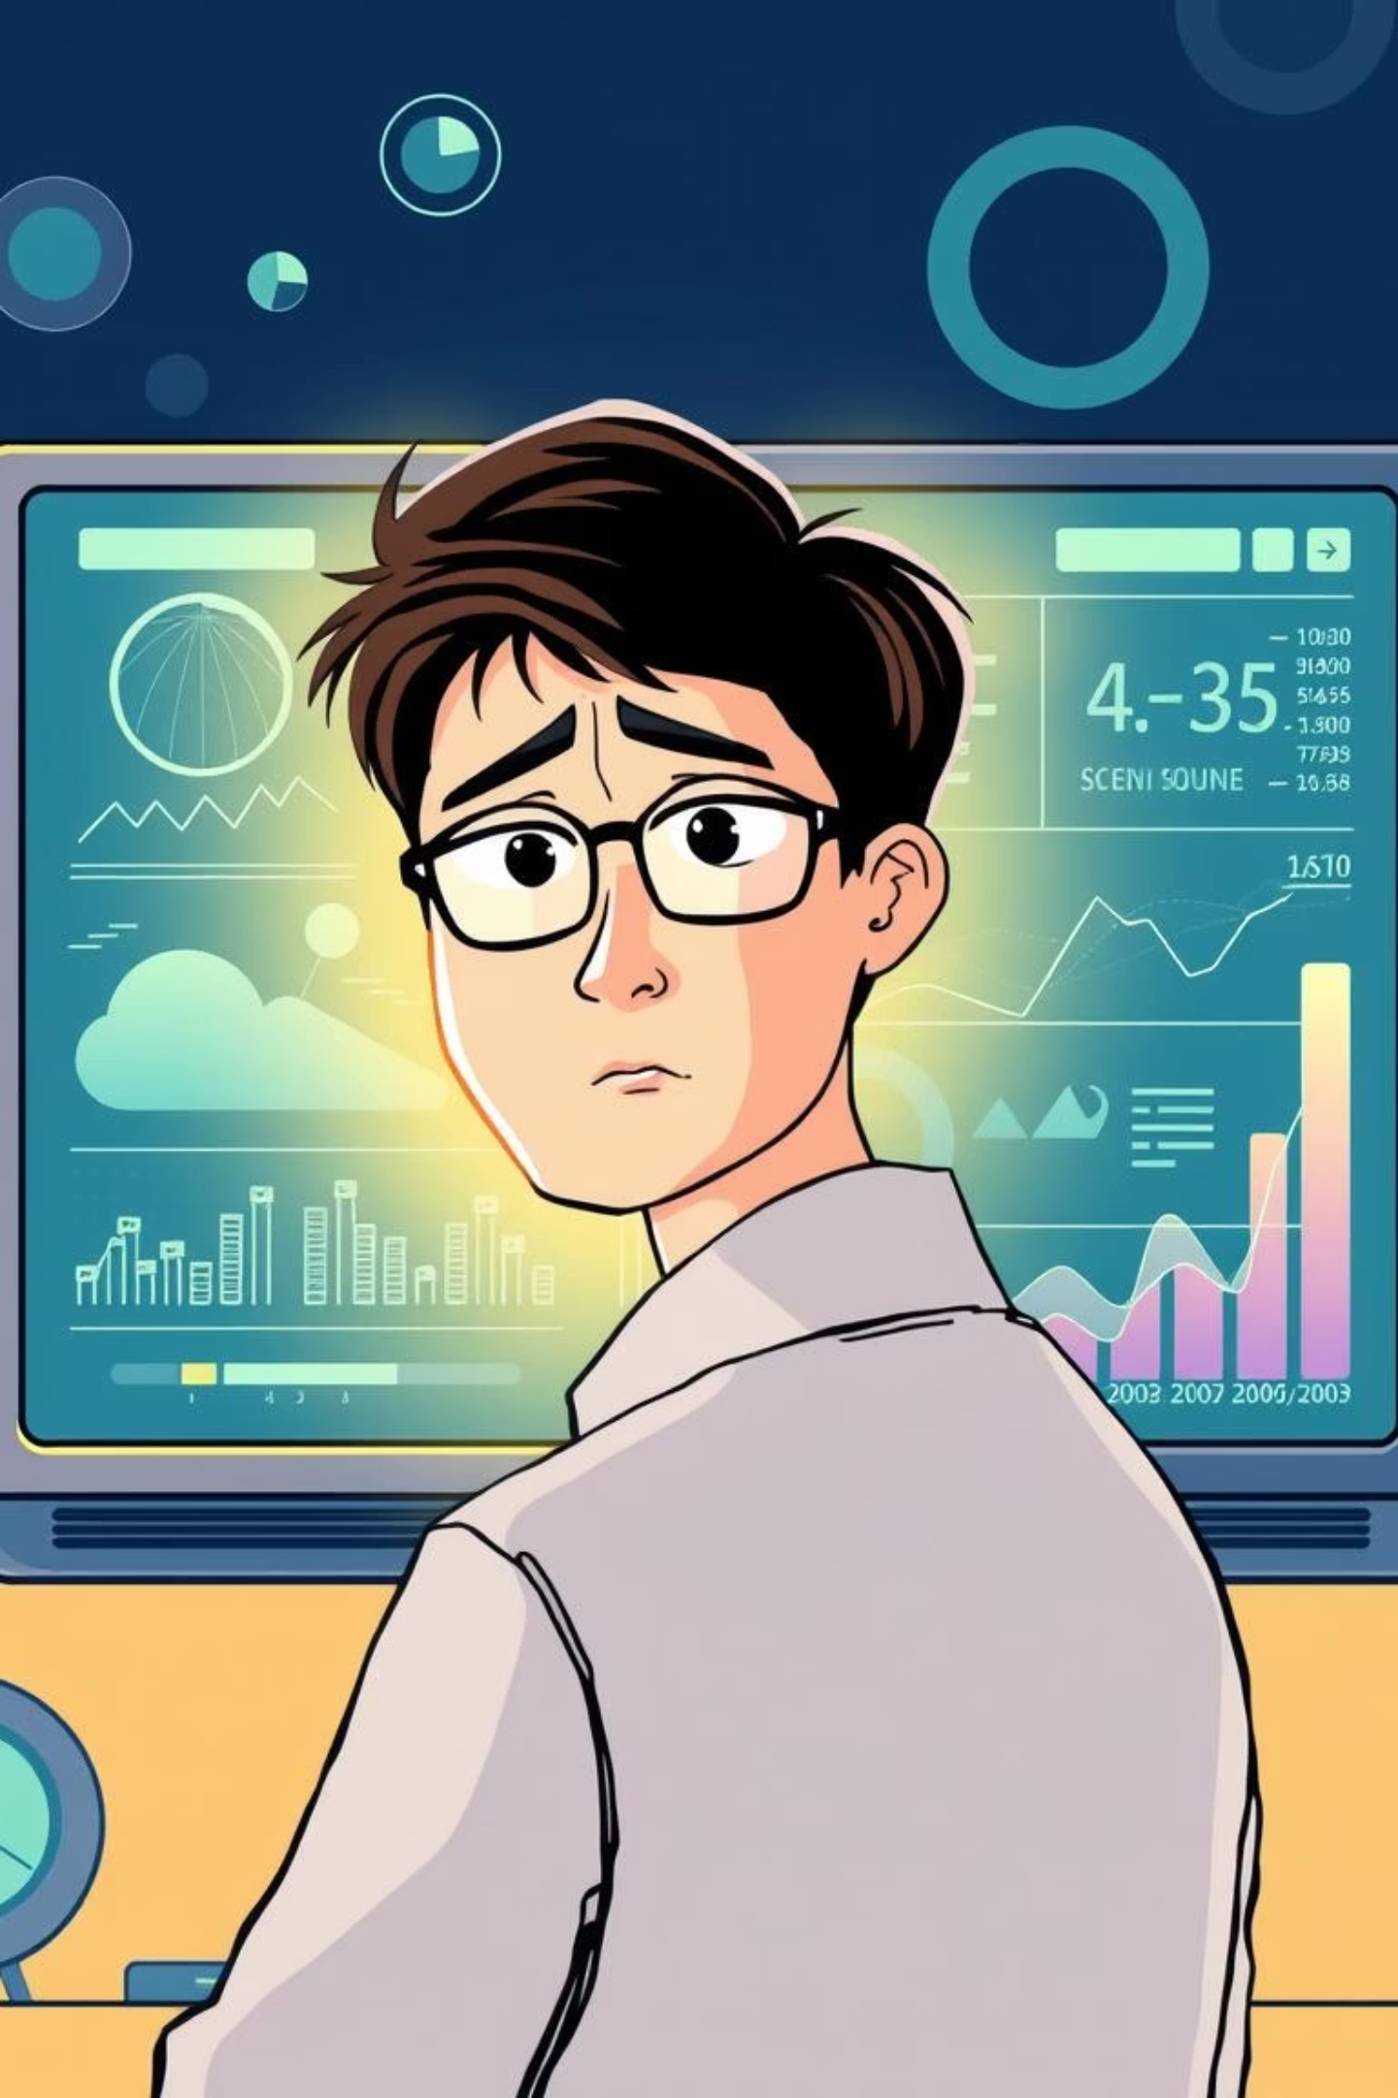

Problem Statement: Smart Meter Data Fatigue
Traditional smart meter systems overwhelm users with large volumes of raw data and generic visualizations, offering little personalization or actionable guidance. As a result, users struggle to interpret consumption patterns and translate them into meaningful behavioral changes, leading to disengagement and missed opportunities for energy and cost savings.

Slide 5
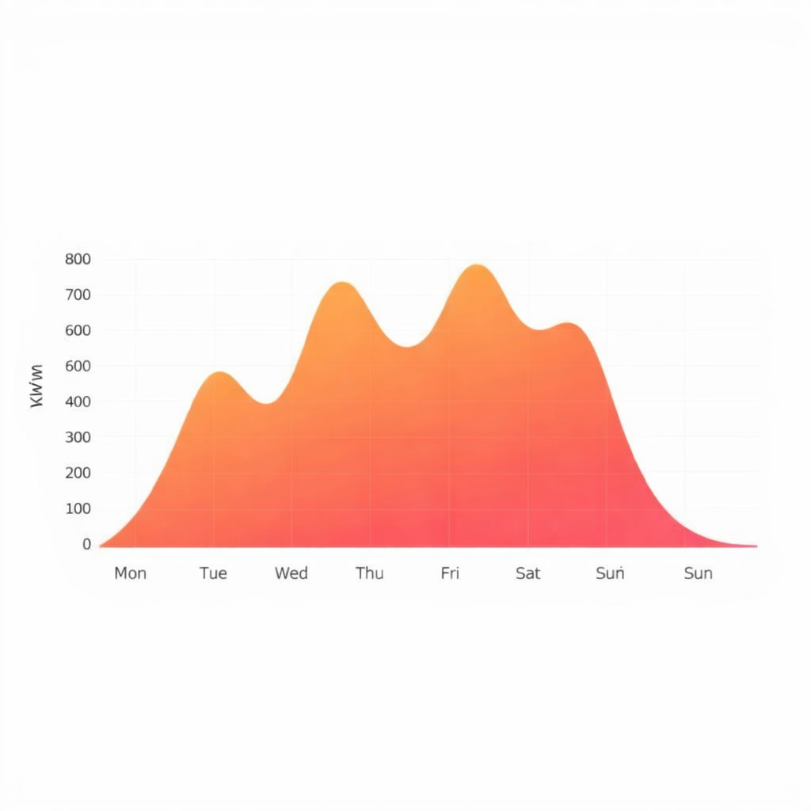



Which Gap is this Approach Filling?
Raw Data Presentation
Many smart meter systems simply display consumption data without context or interpretation.
User Interpretation Burden
Users are left to analyze trends and figure out energy-saving strategies on their own.
Actionable, Personalized Advice
Our advisor bridges this gap by providing tailored, easy-to-understand recommendations directly to the user.
This project moves beyond mere data reporting to create a proactive, intelligent partner in energy management, significantly enhancing the value proposition of smart meter infrastructure.

Slide 6


System Architecture & Workflow
Smart Meter Data
Data Preprocessing
Prediction Model
LLM Advice → Dashboard
Our system processes raw smart meter data through a robust pipeline, culminating in an intuitive user interface. This ensures seamless integration from data acquisition to actionable insights, driving behavioral change.

Slide 7
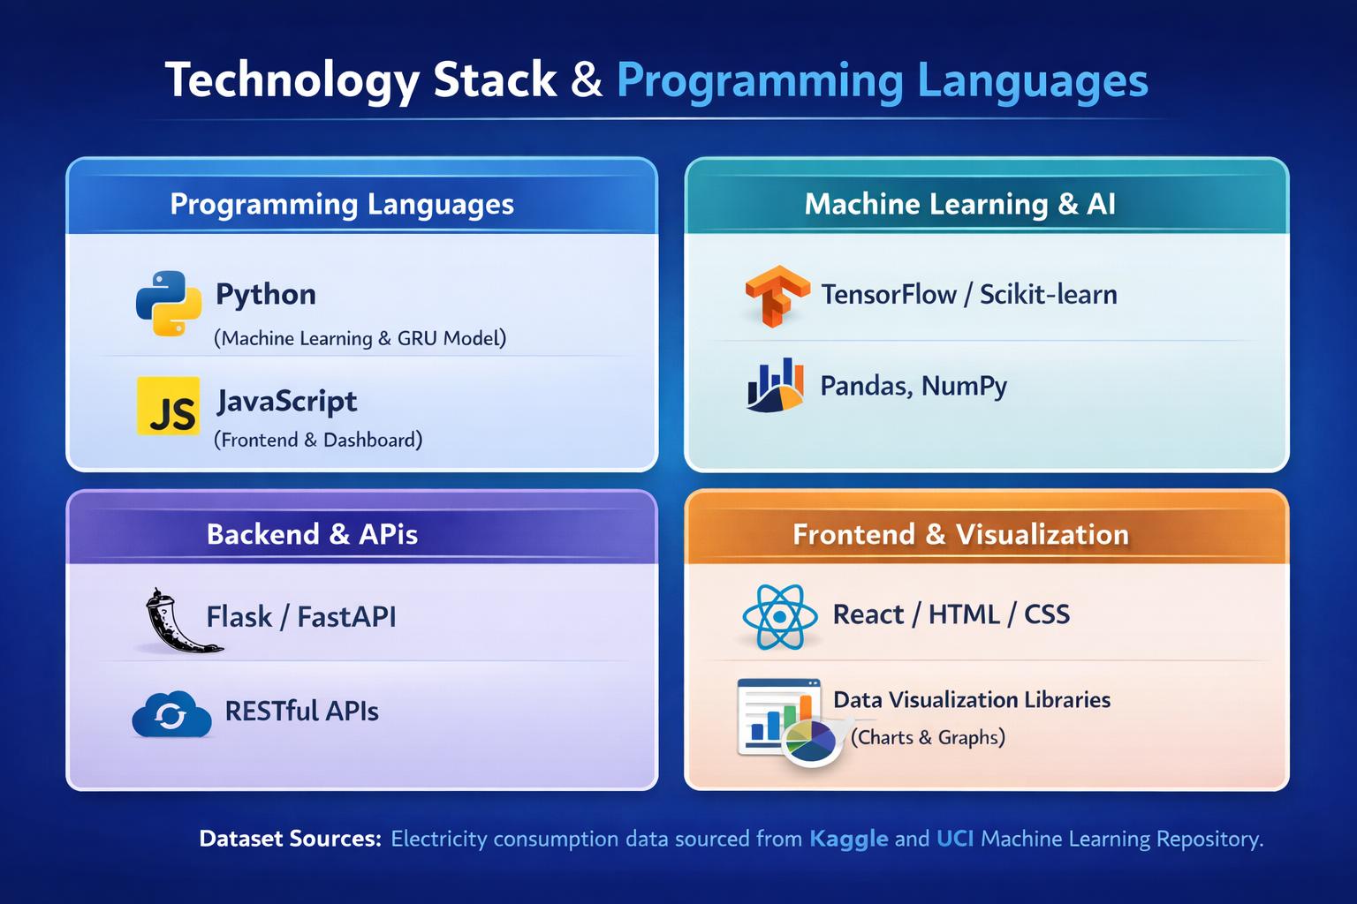

Energy Usage Prediction Model

Slide 8
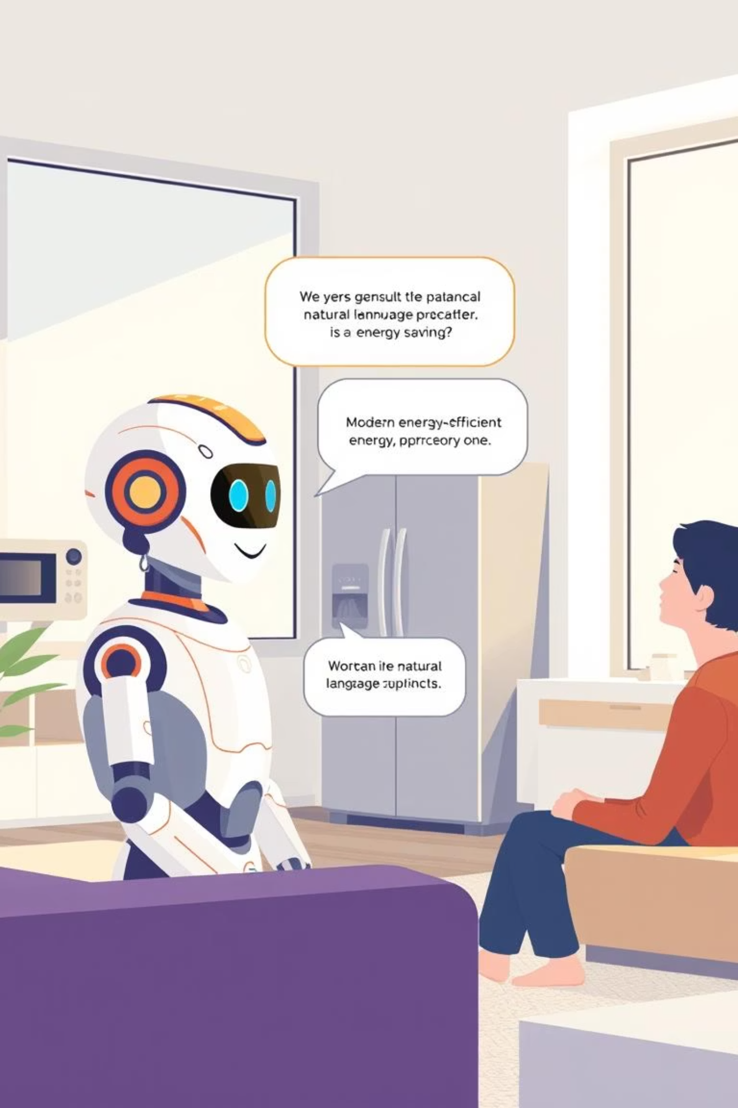
LLM-Based Personalized Behavioral Advice
Contextual Understanding
Tailored Recommendations
Our Large Language Model (LLM) interprets complex usage patterns, recognizing specific appliance use and habits.
The LLM generates personalized advice, such as "Consider unplugging your gaming console at night; it's drawing significant phantom load."
Engaging Communication
Advice is presented in clear, friendly language, making it easy for users to understand and act upon.

Slide 9




Impact, Evaluation Metrics & Future Scope
Environmental Impact
Economic Savings
Behavioral Shift
Reduced carbon footprint through optimized energy consumption.
Lower utility bills for households and businesses.
Long-term adoption of sustainable energy habits.
15%
80%
75%
Future Scope
Can be expanded with real-time IoT and renewable energy integration for smart city–level energy management.

Slide 10
Thank You

